Slide 1



Hackathon -
Final Event!

Slide 2

Game #1:
Arabacman
Omer, Naya, Fahmi, Gilad, Stav and Eitan

Slide 3
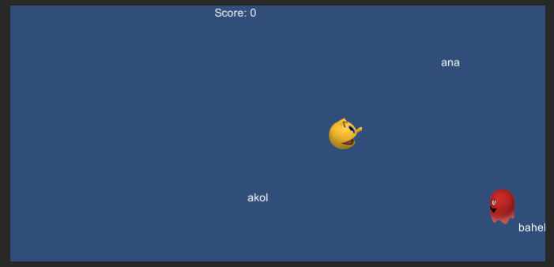

Slide 4
Our game helps with...
A fun and engaging game
A break from more serious lessons Accessible to all ages
Many options for future development...

Slide 5
Where should the game
Be located?
That’s the beautiful thing: can work well with many different lessons, subjects and teaching methods

Slide 6
Other special notes:
A homage to a classic video game.
We believe it’ll set Madrasa apart from your average language teaching games.
A few examples for way it can be used:
Spoken Arabic to pictures, Written Arabic to pictures, building of whole sentences and so much more...

Slide 7


Make a short demonstration video!
.
مرحبا

Slide 8
What’s next?
Multi-Player, harder levels, added sound and more challenges!

Slide 9
Thank you!

Slide 10

Game #2:
Hitchman
Oded Sayar
Maor Blyachman
Sima Wattad
Mohammed Rezeq
Sameh Fuqaha

Slide 11
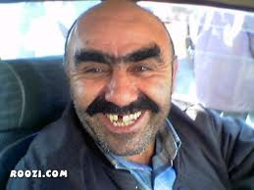
The problem
Most Israelis don’t know how to start a simple conversation in Arabic.
But what happens when their ride home is Hamudi?

Slide 12
Our game helps with...
Daily street language practice.
Hitchiker oriented.
Learning 3arabizi

Slide 13
Where should the game
Be located?
External to the course - Fun Games

Slide 14
Other special notes:
Cross Platform game:
Mobile
Web
PC
FUN
Extendable

Slide 15
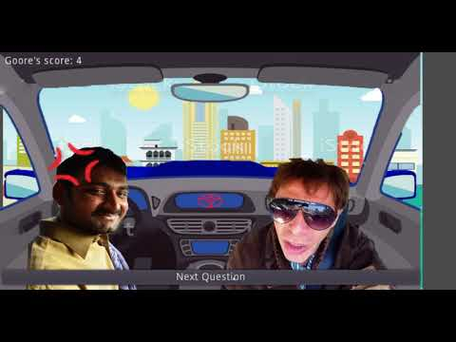
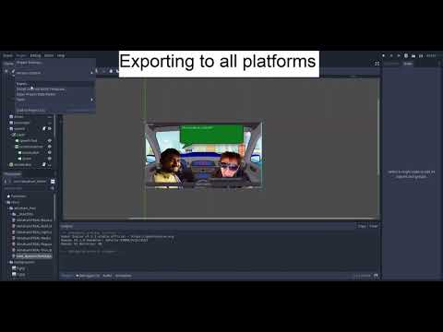
Make a short demonstration video!
.
مرحبا

Slide 16

Coming Soon...
Adaptive level and content
Game Start/Game Over
New theme for each question
Madrasa like UI
Users Leaderboard
Transliteration support

Slide 17
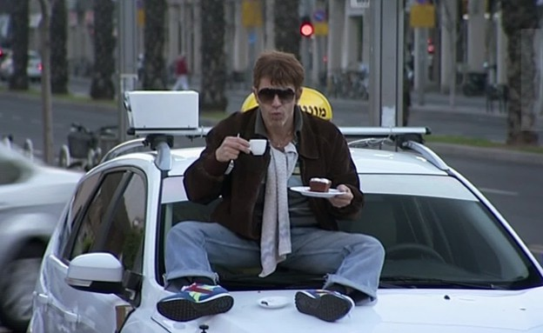
Thank you!

Slide 18
Game #3: Interactive texts
Shadi Jaacob khoury, Roey Hel-Or
Sima Wattad, Neveh Porat
Elad Eckstein, Samech, Sophe, Hadas

Slide 19
Our platform helps generate games that...
Are engaging ,creative and fun.
Can be customised to different levels and themes.
Enrich the learning experience.
Are easy to create!

Slide 20

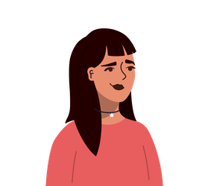
Students
Game Creators
Rich and diverse learning experience
Personalized
Endless possibilities
Customizable and easy to create content

Slide 21
Where should the game
Be located?
Anywhere!
The ‘Interactive text’ platform generates games that can easily be embedded in all of Madrasa’s courses and external content library.

Slide 22
Other special notes:
Achieved
In development
Built a platform for creators to generate interactive and engaging text based games that can be customized to any level or theme
The platform allows you to introduce audio, photos and video cues that makes the learning effective.
A more user friendly interface to enable anyone to add questions
Integration with Madrassa’s course DB

Slide 23
Let’s make games!
.
مرحبا

Slide 24
.
مرحبا

Slide 25
What’s next?
-As we build a more larger DB we can generate more levels.
- with the help of analytics we can personalize the questions for each student in the class.

Slide 26
Thank you!

Slide 27
ועכשיו הזמן שלכם כאן ובבית להצביע :)
הלינק להצבעה בתגובות
יש לכם 5 דקות!

Slide 28
